Slide 1
Interpretable AI
Azure Machine Learning Services
Azure Machine Learning Meetup
November 7 , 2019

Slide 2
agenda
Welcome and intros
Background and context of interpretable and explainable AI
Azure ML capabilities
Demo/walkthrough
Additional tooling
Q&A

Slide 3
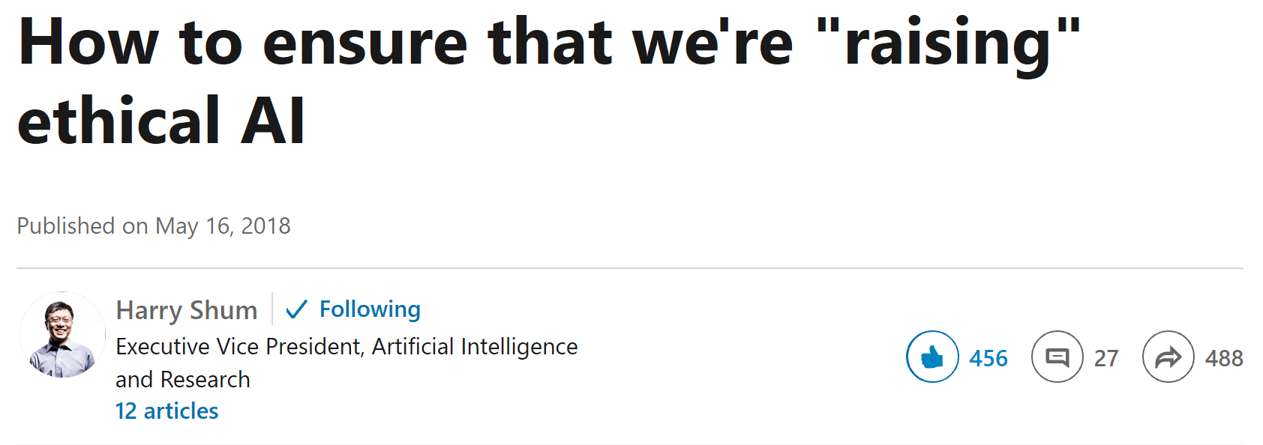
Microsoft
Transparency—ensuring we can understand and see the decisions that AI is making—is an ethical imperative that centers around the field of what we call Explainable AI, or in other words, answering “why?”
Accountability means making sure that we not only understand why AI has come to a certain conclusion but also ensure that there is direct human responsibility to oversee important decisions. We call this having a “human in the loop.”
https://www.linkedin.com/pulse/how-ensure-were-raising-ethical-ai-harry-shum/

Slide 4
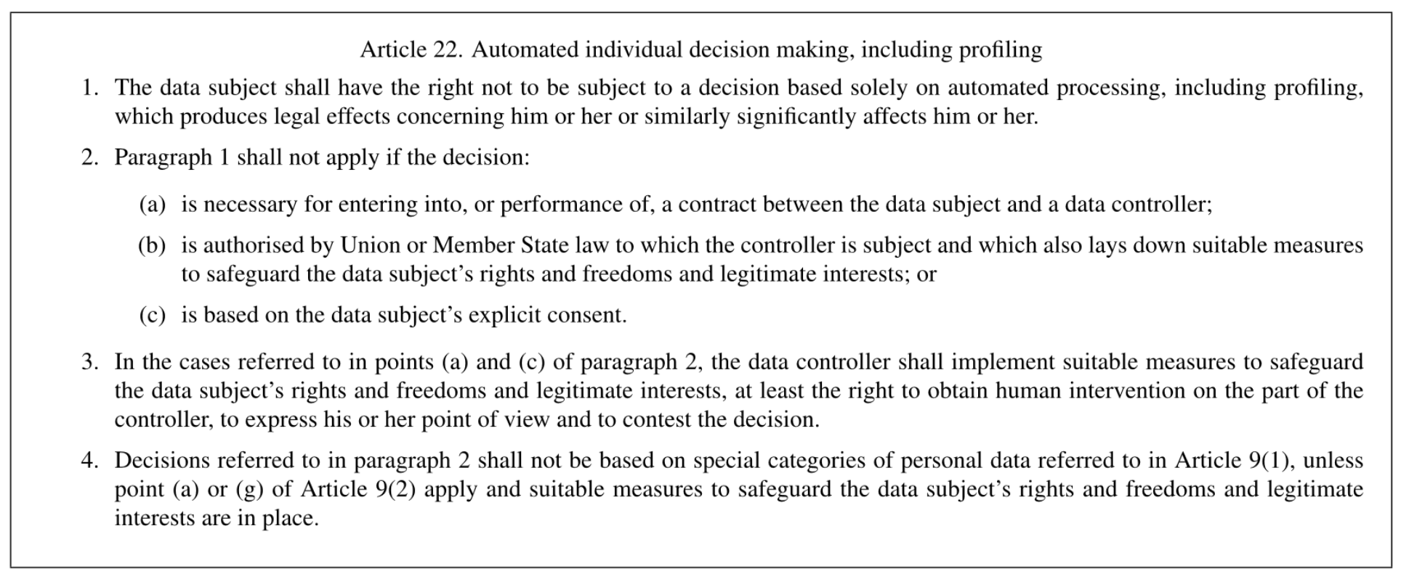
GDPR – Right to Explain

Slide 5
Example of how learning differs
… In contrast, machine vision systems powered by deep neural networks can sometimes even outperform humans at recognizing a cat under fixed conditions, but images that are even a little novel, noisy or grainy can throw off those systems completely.
A research team in Germany has now discovered an unexpected reason why: While humans pay attention to the shapes of pictured objects, deep learning computer vision algorithms routinely latch on to the objects’ textures instead
Source:
https://www.quantamagazine.org/where-we-see-shapes-ai-sees-textures-20190701/

Slide 6
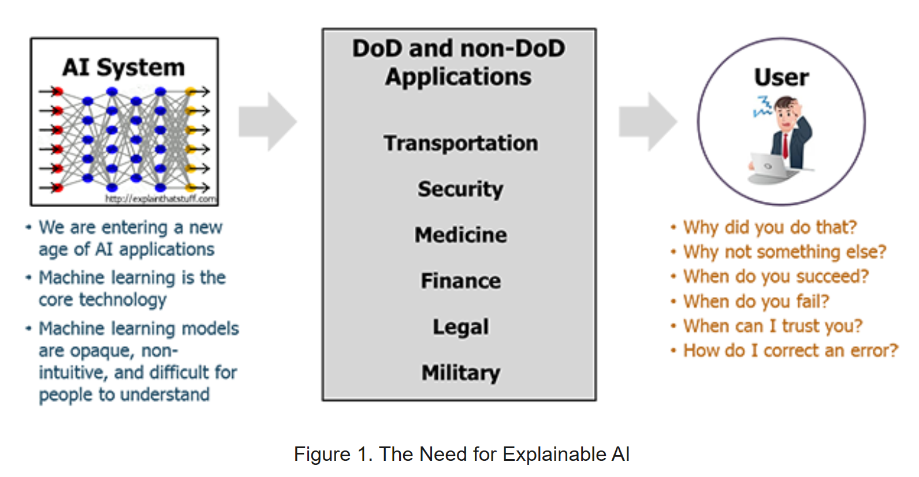
DARPA Explainable AI (XAI) Initiative
DARPA = Defense Advanced Research Projects Agency
$75 million project involving 100 researchers from 30 universities
https://www.darpa.mil/program/explainable-artificial-intelligence

Slide 7








Responsible & Transparent AI
Responsible AI -
Sensitive Use Cases
Accountability - Transparency
Denial Of Service
Risk of Harm
Infringe on human rights
Intelligibility
Reproducibility
Data Lineage
This session

Slide 8

Why adopt DevOps for AI?
Manage pain points:
data scientists and software engineers
Scripts stored on one person's machine and process not repeatable
Model versioning based on names, hard to know where model is deployed
Accuracy of model is determined during training and might change over time because of the data drift
Determine the value of the trained model, decide if it should be deployed

Slide 9
What does azure machine learning explaninability packages offer?
Goal: to explain machine learning models globally on all data, or locally on a specific data point using the state-of-art technologies in an easy-to-use and scalable fashion.
There are multiple frameworks – we’ll focus on one set integrated into azure machine learning services

Slide 10
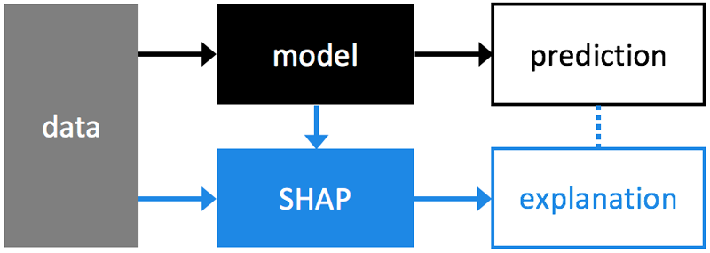
General background - SHAP
SHAP (SHapley Additive exPlanations) unified approach to explain the output of any machine learning model
https://shap.readthedocs.io/en/latest/

Slide 11
How is the toolkit designed?
Incorporates interpretability solutions developed by Microsoft and leverages proven third-party libraries
Creates a common API and data structure across the integrated libraries and integrates AML services
You integrate the API into your existing python scripts and notebooks
You can use them without using any of the other AML services or features
# Using SHAP TabularExplainer
explainer = TabularExplainer(model,
x_train,
features = boston_data.feature_names)
…
global_explanation = explainer.explain_global(x_test)

Slide 12
The capabilities (what can I do with this)
Using the classes and methods in the Azure ML SDK, you can get:
Feature importance values for both raw and engineered features
Interpretability on real-world datasets at scale, during training and inference.
Interactive visualizations to aid you in the discovery of patterns in data and explanations at training time
globally on all data, or locally on a specific data point
The interpretability classes are made available through multiple SDK packages
There is an independent package for general use that we won’t cover this evening, reference on last page.
https://docs.microsoft.com/en-us/azure/machine-learning/service/machine-learning-interpretability-explainability

Slide 13
details
Training Time Input: model + training data
Any models that are trained on datasets in Python
`numpy.array`,
`pandas.DataFrame`,
`iml.datatypes.DenseData`,
or `scipy.sparse.csr_matrix` format
Accepts both models and pipelines as input.
Model: model must implement the prediction function `predict` or `predict_proba` that conforms to the Scikit convention.
Pipeline: the explanation function assumes that the running pipeline script returns a prediction.

Slide 14
Model details
methods can be also categorized based on whether the method is model agnostic or model specific
Some methods treat the model as a black box, such as mimic explainer or SHAP’s kernel explainer.
The explain package leverages these different approaches based on data sets, model types, and use cases.
The output is a set of information on how a given model makes its prediction, such as:
Global/local relative feature importance
Global/local feature and prediction relationship
print('ranked global importance names: {}'.format(global_explanation.get_ranked_global_names()))
>ranked global importance names: ['LSTAT', 'RM', 'PTRATIO', 'DIS', 'NOX', 'CRIM’, …

Slide 15
WHAT ARE Direct Explainers and Meta Explainers
Direct explainers come from integrated libraries. The SDK wraps all the explainers so that they expose a common API and output format.
There is a large number of direct explainers to choose from – they can be used individually or can serve as building blocks for automation such as…
Meta explainers automatically select a suitable direct explainer and generate the best explanation info based on the given model and data sets.
Tabular Explainer: Used with tabular datasets.
Text Explainer: Used with text datasets.
Image Explainer: Used with image datasets.
Meta explainers develop additional features on top of the underlying libraries and improve the speed and scalability over the direct explainers

Slide 16
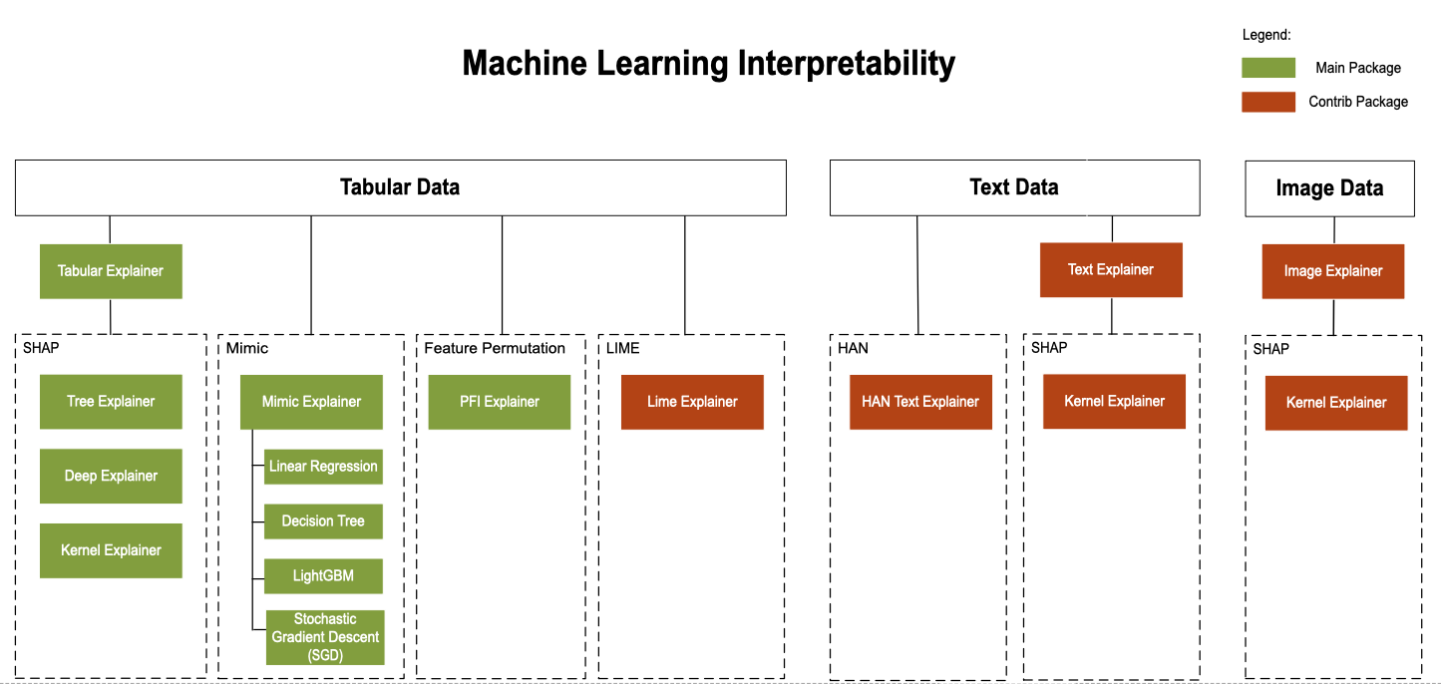
As of October 2019 the explainer map

Slide 17
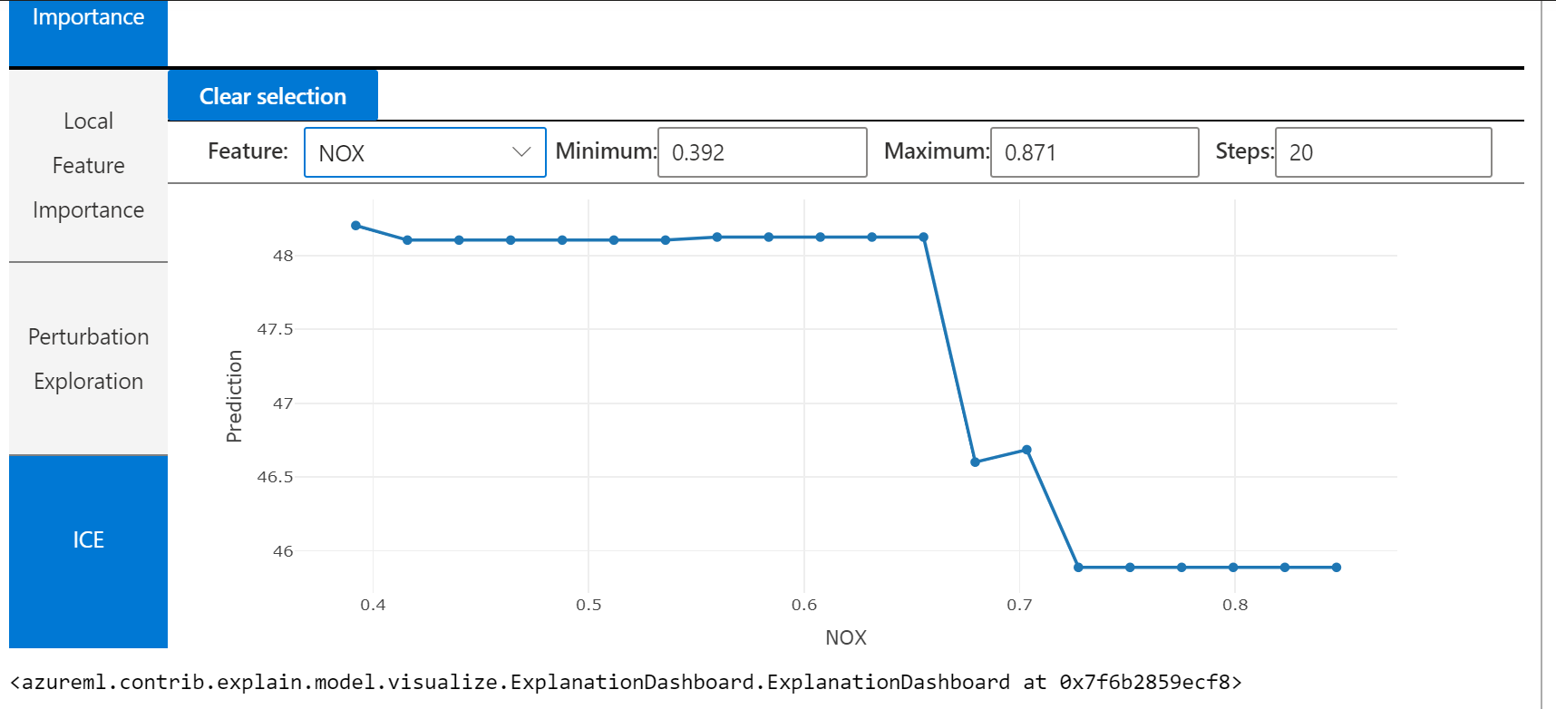
Demo and walkthrough
These are built in demos that you can also try since they are integrated with Azure Machine Learning Services.
What is ICE?
Individual Conditional Expectation (ICE)
Allows you to change a feature value from a minimum value to a maximum value to see how the data point's prediction changes when a feature changes.

Slide 18
Machine Learning Interpretability Toolkit
Train your model
and create an explainer
Store explanations to the run history
Register corresponding explainer
And explain predictions
Notes:
Develop machine learning training scripts in Python.
Create and configure a compute target.
Submit the scripts to the configured compute target to run in that environment. During training, the scripts can read from or write to datastore. And the records of execution are saved as runs in the workspace and grouped under experiments.
Query the experiment for logged metrics from the current and past runs. If the metrics don't indicate a desired outcome, loop back to step 1 and iterate on your scripts.
After a satisfactory run is found, register the persisted model in the model registry.
Develop a scoring script.
Create an image and register it in the image registry.
Deploy the image as a web service in Azure.

Slide 19
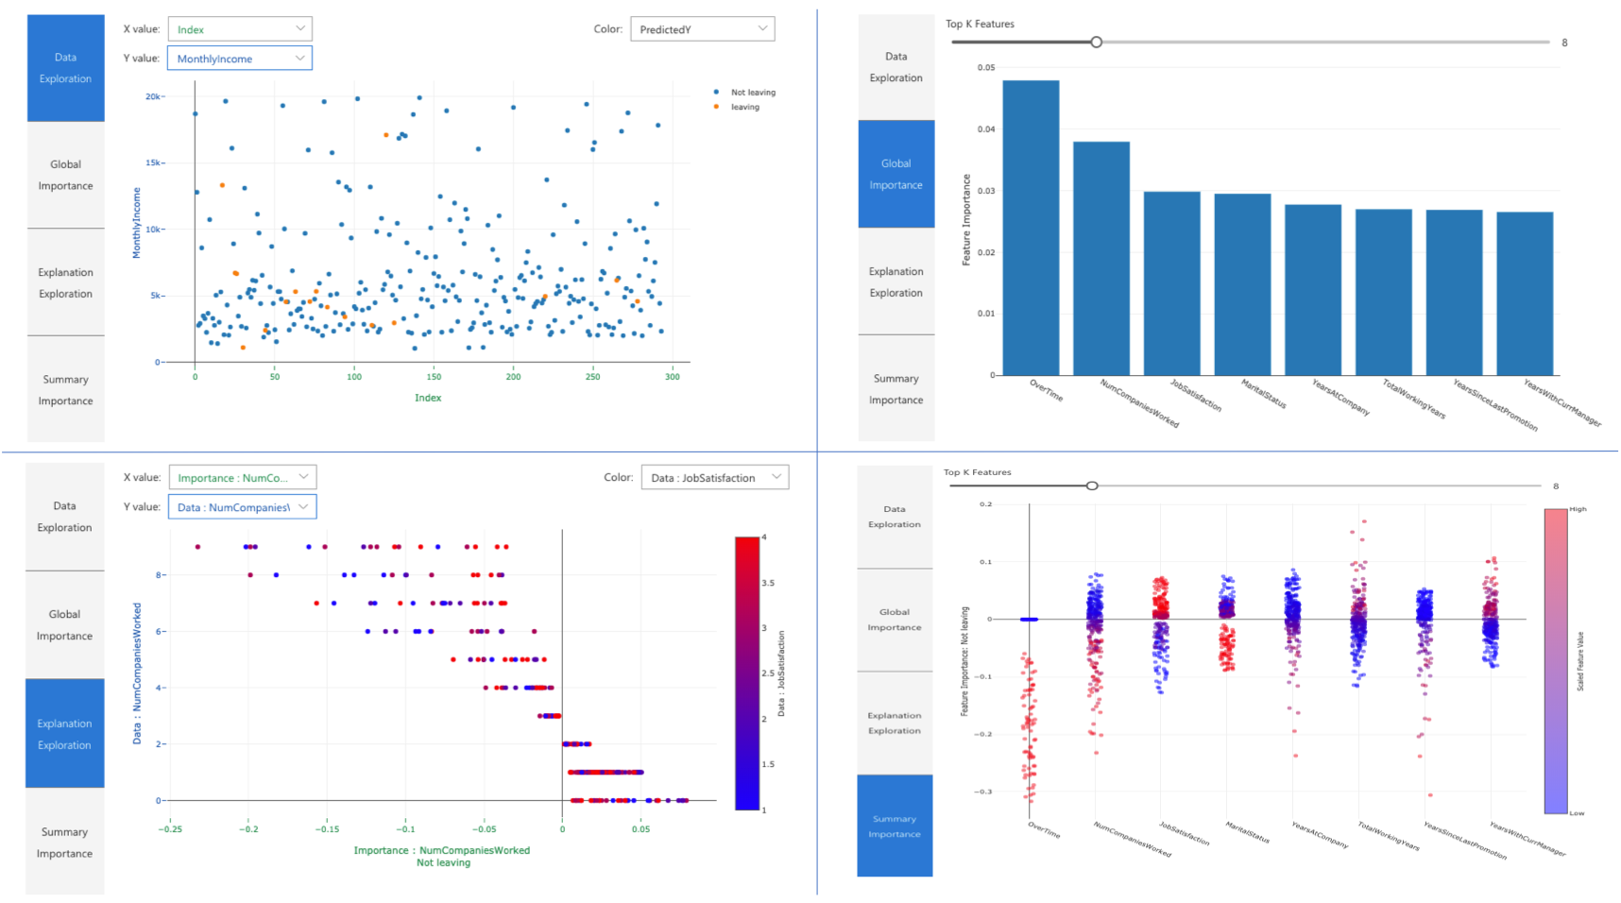
Transparent AI – Part of the lifecycle
Dev Ops for Machine Learning on Azure
Model Interpretability in the Azure Machine Learning Service
InterpretML toolkit for training & editing interpretable models
https://aischool.microsoft.com/en-us/machine-learning/learning-paths/introduction-to-interpretml

Slide 20
Additional resources
https://allennlp.org/interpret
https://channel9.msdn.com/Shows/AI-Show/Machine-Learning-Interpretability-Toolkit (guide to azure explain visuals)
Fairlearn: https://github.com/fairlearn (support in azure ml services coming)
Content for this meetup at:
https://github.com/jimwill3/NY-AZML-Meetup/tree/CNTK/explainAI
Thank you

